Slide 1

CSE211
Computer Organization and Design
Lecture : 3
Tutorial: 1
Practical: 0
Credit: 4
1

Slide 2
Unit 1 : Basics of Digital Electronics
Introduction
Logic Gates
Combinational / Sequential circuits
Flip Flops
Registers
Decoder / Encoder
Multiplexers / Demultiplexer
Binary counters
1

Slide 3
Whose operations are more faster among the following?
Combinational circuits
Sequential circuits
Latches
Flip-flops
Answer: a
Explanation: Combinational circuits are often faster than sequential circuits. Since, the combinational circuits do not require memory elements whereas the sequential circuits need memory devices to perform their operations in sequence. Latches and Flip-flops come under sequential circuits.

Slide 4
Table 1
How |  | many |  | types | of | sequential | circuits | are?
a) | 2
b) | 3
c) | 4
d) | 5
Answer: a
Explanation: There are two type of sequential circuits viz., (i) synchronous or clocked and (ii) asynchronous or unclocked. Synchronous Sequential Circuits are triggered in the presence of a clock signal, whereas, Asynchronous Sequential Circuits function in the absence of a clock signal.

Slide 5
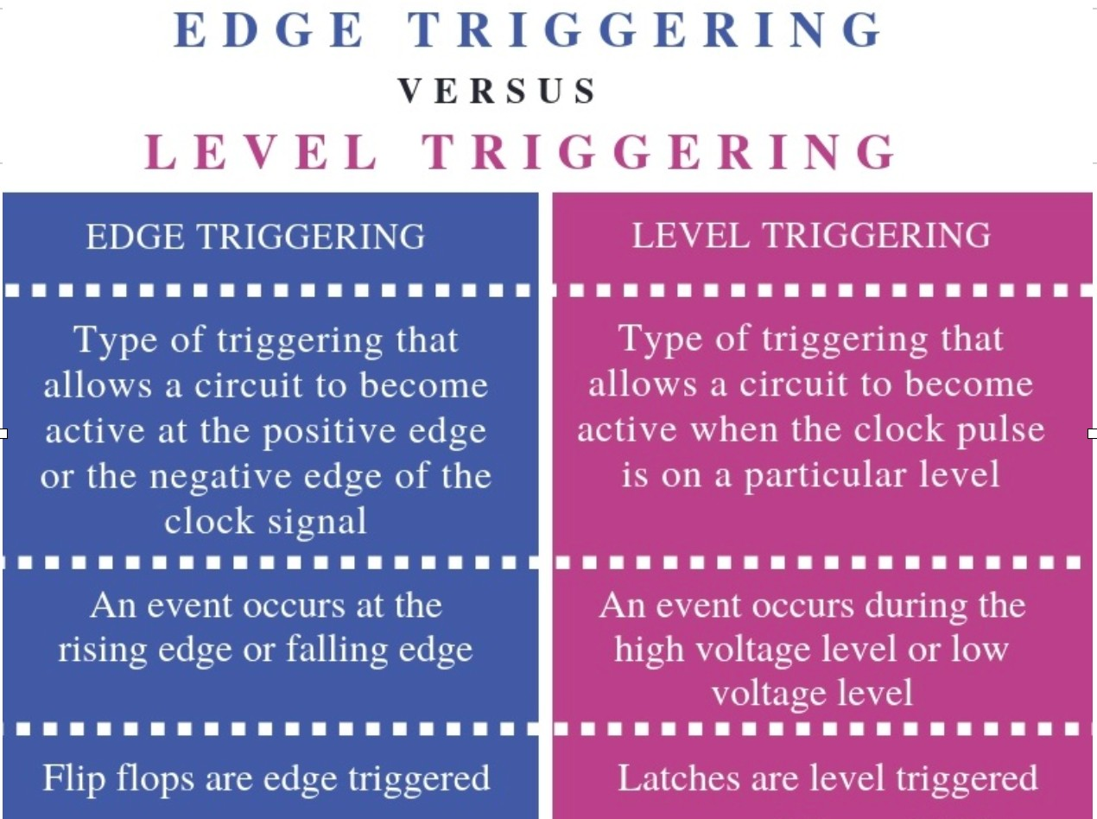
5

Slide 6
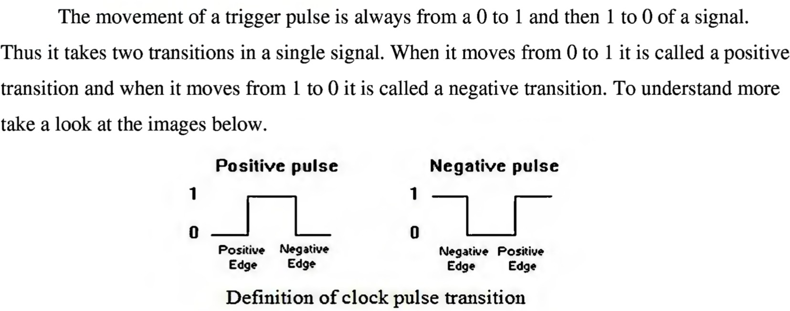
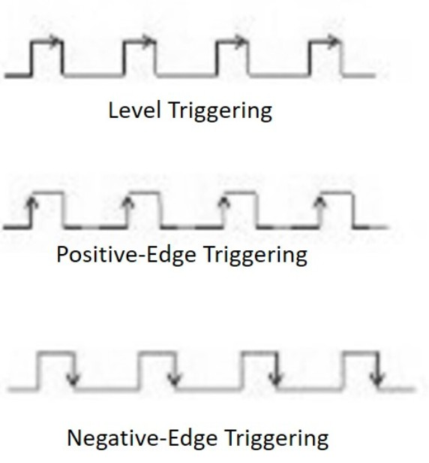
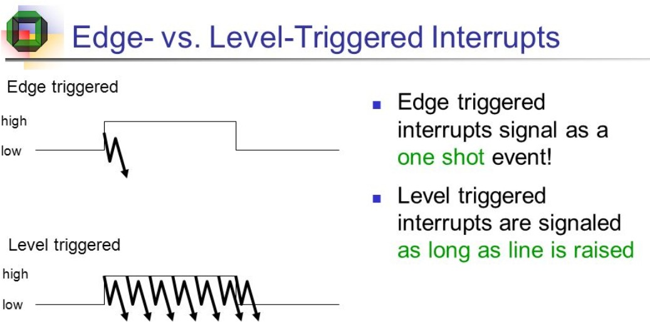
5

Slide 7

FLIP FLOPS
Flip-flop is a circuit that maintains a state until directed by input to change the state.
A basic flip-flop can be constructed using four-NAND or four- NOR gates.
Types of flip-flops:
SR Flip Flop
JK Flip Flop
D Flip Flop
T Flip Flop
5

Slide 8
Applications of Flip-Flops
Various types of flip-flops are being used in digital electronic circuits and the applications of Flip-flops are as specified below.
Counters
Frequency Dividers
Shift Registers
Storage Registers
Bounce elimination switch
Data storage
Data transfer
Latch
Registers
Memory
5

Slide 9
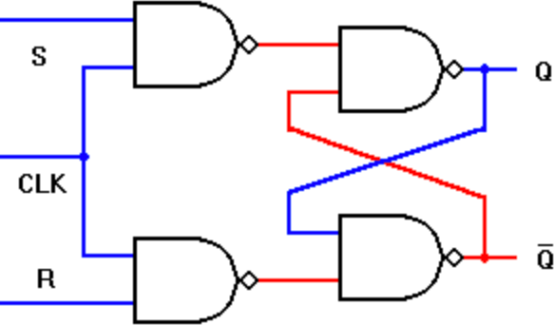
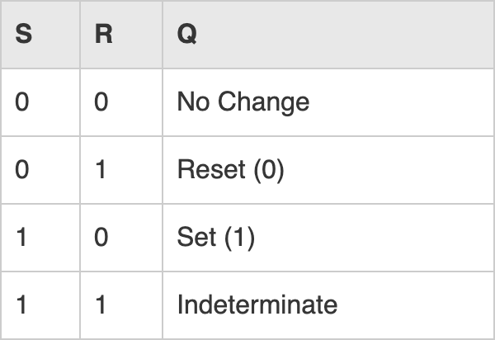
S(set)/R(reset) Flip Flop
Excitation table

Slide 10
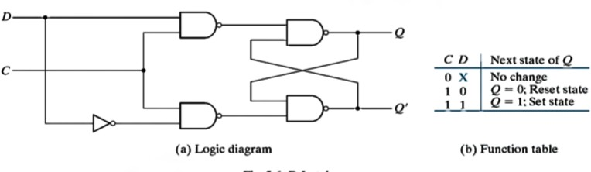
D-FLIP FLOP

Slide 11
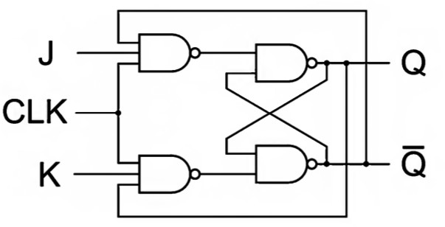
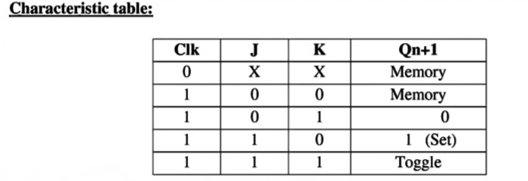
J-K FLIP FLOP

Slide 12
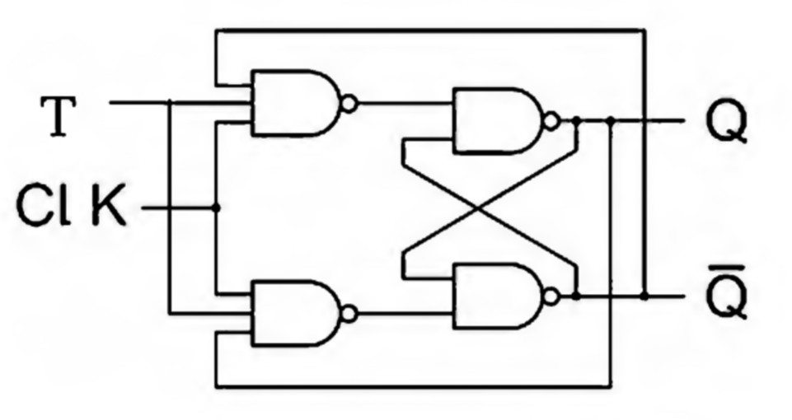
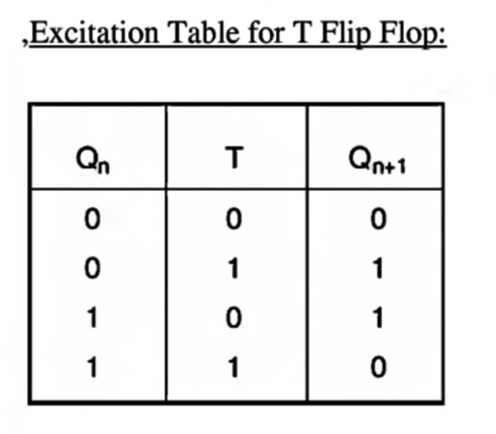
T-FLIP FLOP

Slide 13
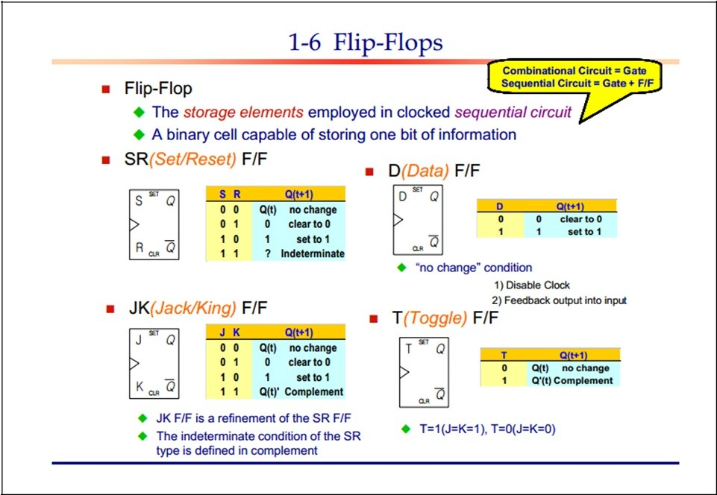

Slide 14
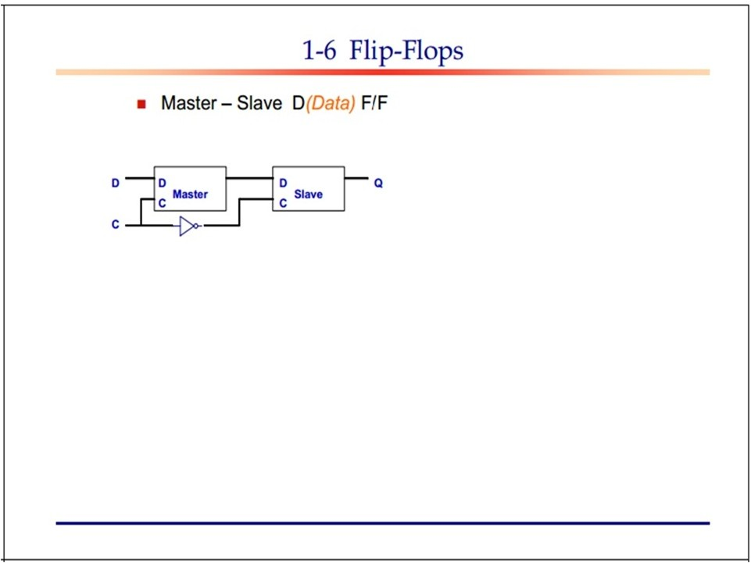
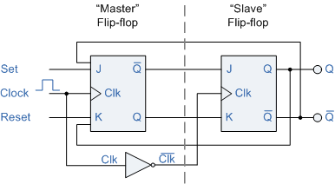
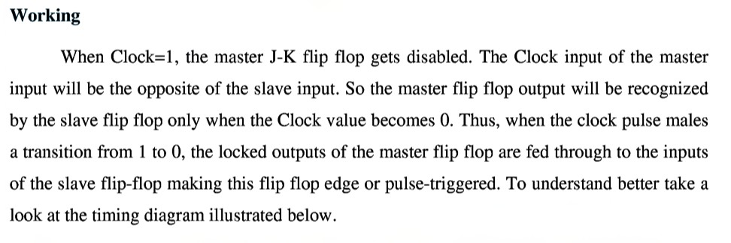

Slide 15
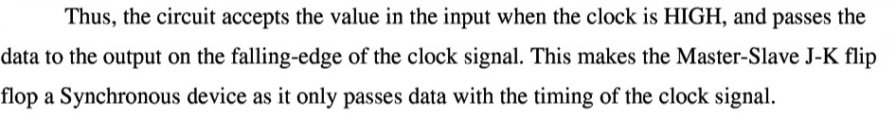
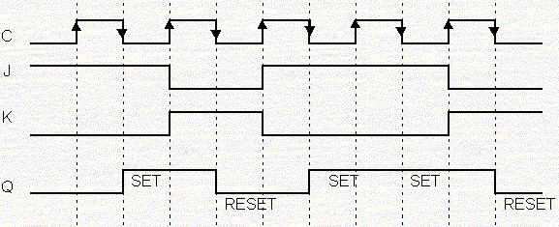

Slide 16
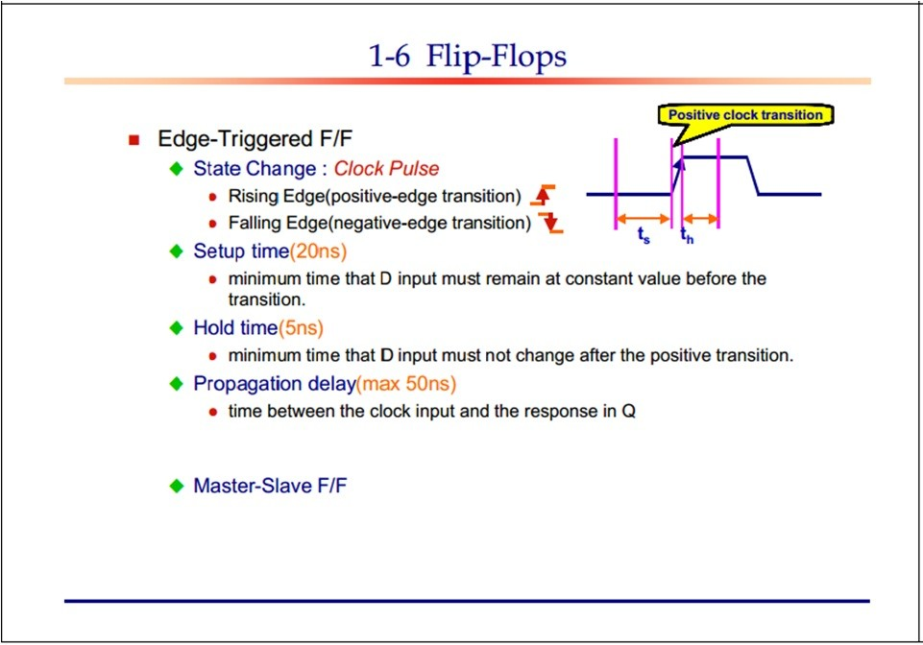
16

Slide 17
What is a multiplexer?
It is a type of decoder which decodes several inputs and gives one output
A multiplexer is a device which converts many signals into one
It takes one input and results into many output
It is a type of encoder which decodes several inputs and gives one output
answer-b
A multiplexer (or MUX) is a device that selects one of several analog or digital input signals and forwards the selected input into a single line, depending on the active select lines

Slide 18
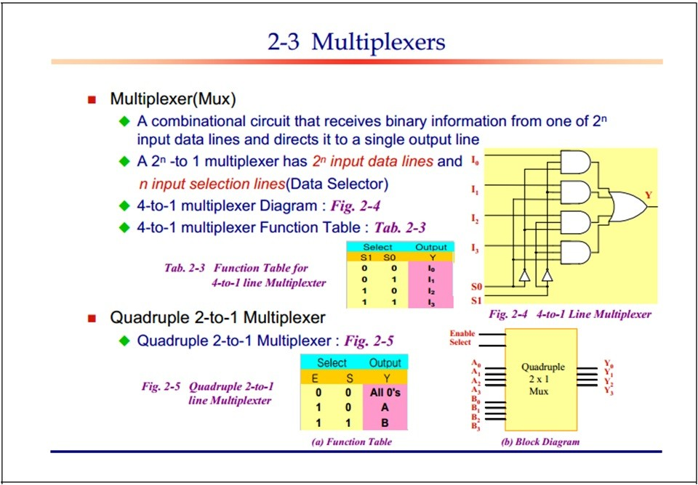

Slide 19
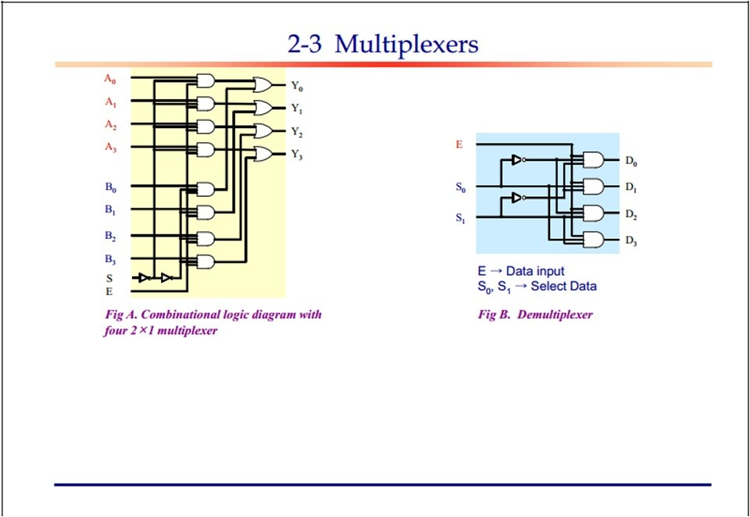
A Demultiplexer, sometimes abbreviated DMUX is a circuit that has one input and more than one output. It is used when a circuit wishes to send a signal to one of many devices

Slide 20
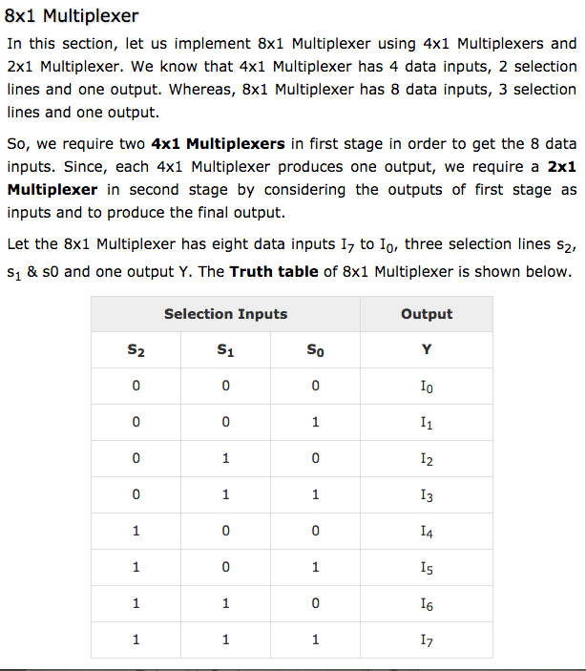

Slide 21
